Slide 1

Miniature Greenhouse Innovation
Peyton Lettau | Sebastian Hondl
John Robinson | Will McConnell
Notes:
Morning everyone. Today I'm presenting our work on designing a mechanism for miniature tabletop greenhouses. This project addresses a real engineering challenge: how do we scale greenhouse technology from full-size applications down to desktop scale? Our solution seeks to uses a six-bar linkage mechanism to provide controlled access to plants while maintaining the functionality of larger greenhouse systems.

Slide 2

Greenhouse Primary Functions
Temperature Control
Short-wave light transmission
Moisture/Humidity Control
Notes:
Let's start with the basics. A greenhouse works by creating a controlled microclimate - it lets in sunlight for photosynthesis while trapping heat and moisture to create an ideal growing environment. The key requirements are high light transmission, thermal retention, moisture control, and balanced ventilation.
But here's the problem: the mechanisms that work great at full scale don't work when you try to scale them down. This is where our project comes in - we need to design new mechanisms specifically for small-scale applications."

Slide 3
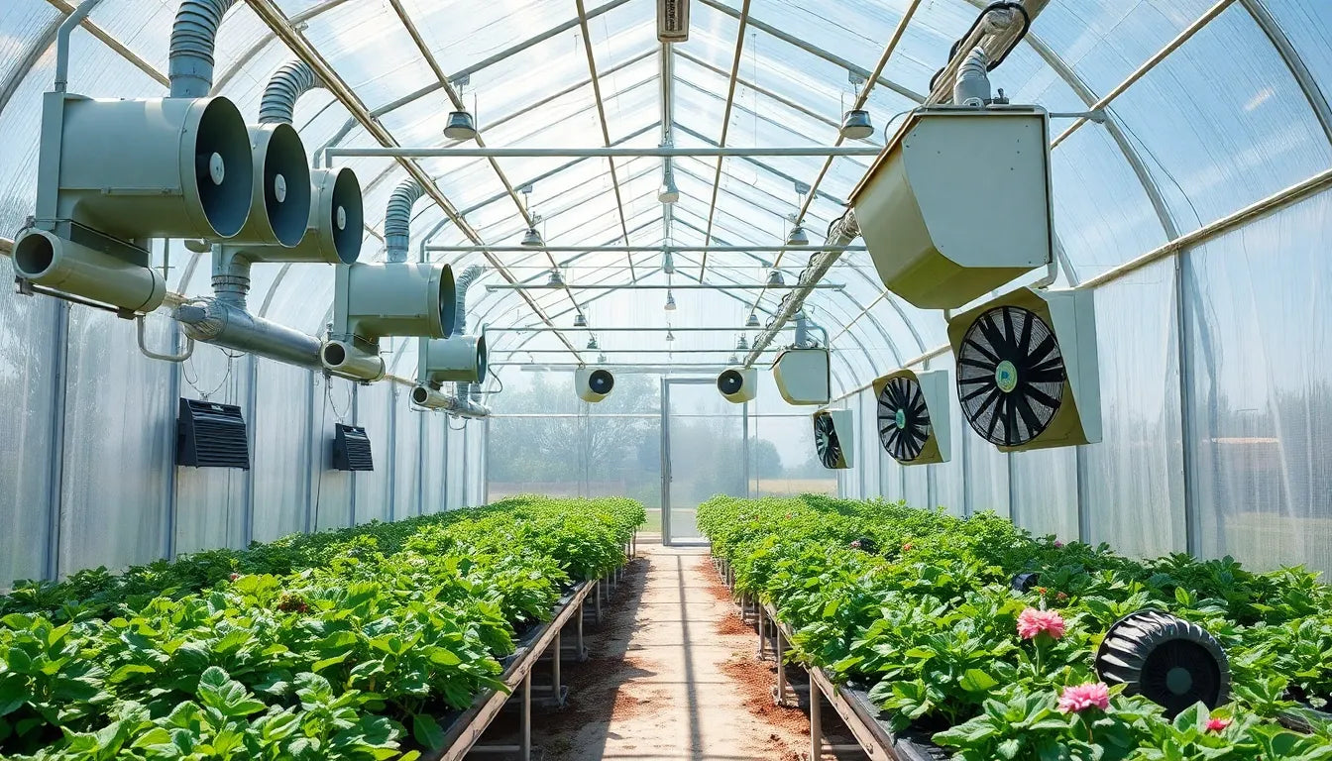
Notes:
Large industrial applications use huge canopies, fans, sensors, heaters, and other cumbersome technology to manager their growing environments.
Now, when we scale this down to desktop size, we face a fundamental challenge: the same principles apply, but we're working in a much more compressed space with new constraints. Now the issues of access, cost, and plant growth conditions are more challenging.
This is where our project comes in - we need to design a new mechanism specifically for small-scale applications.

Slide 4
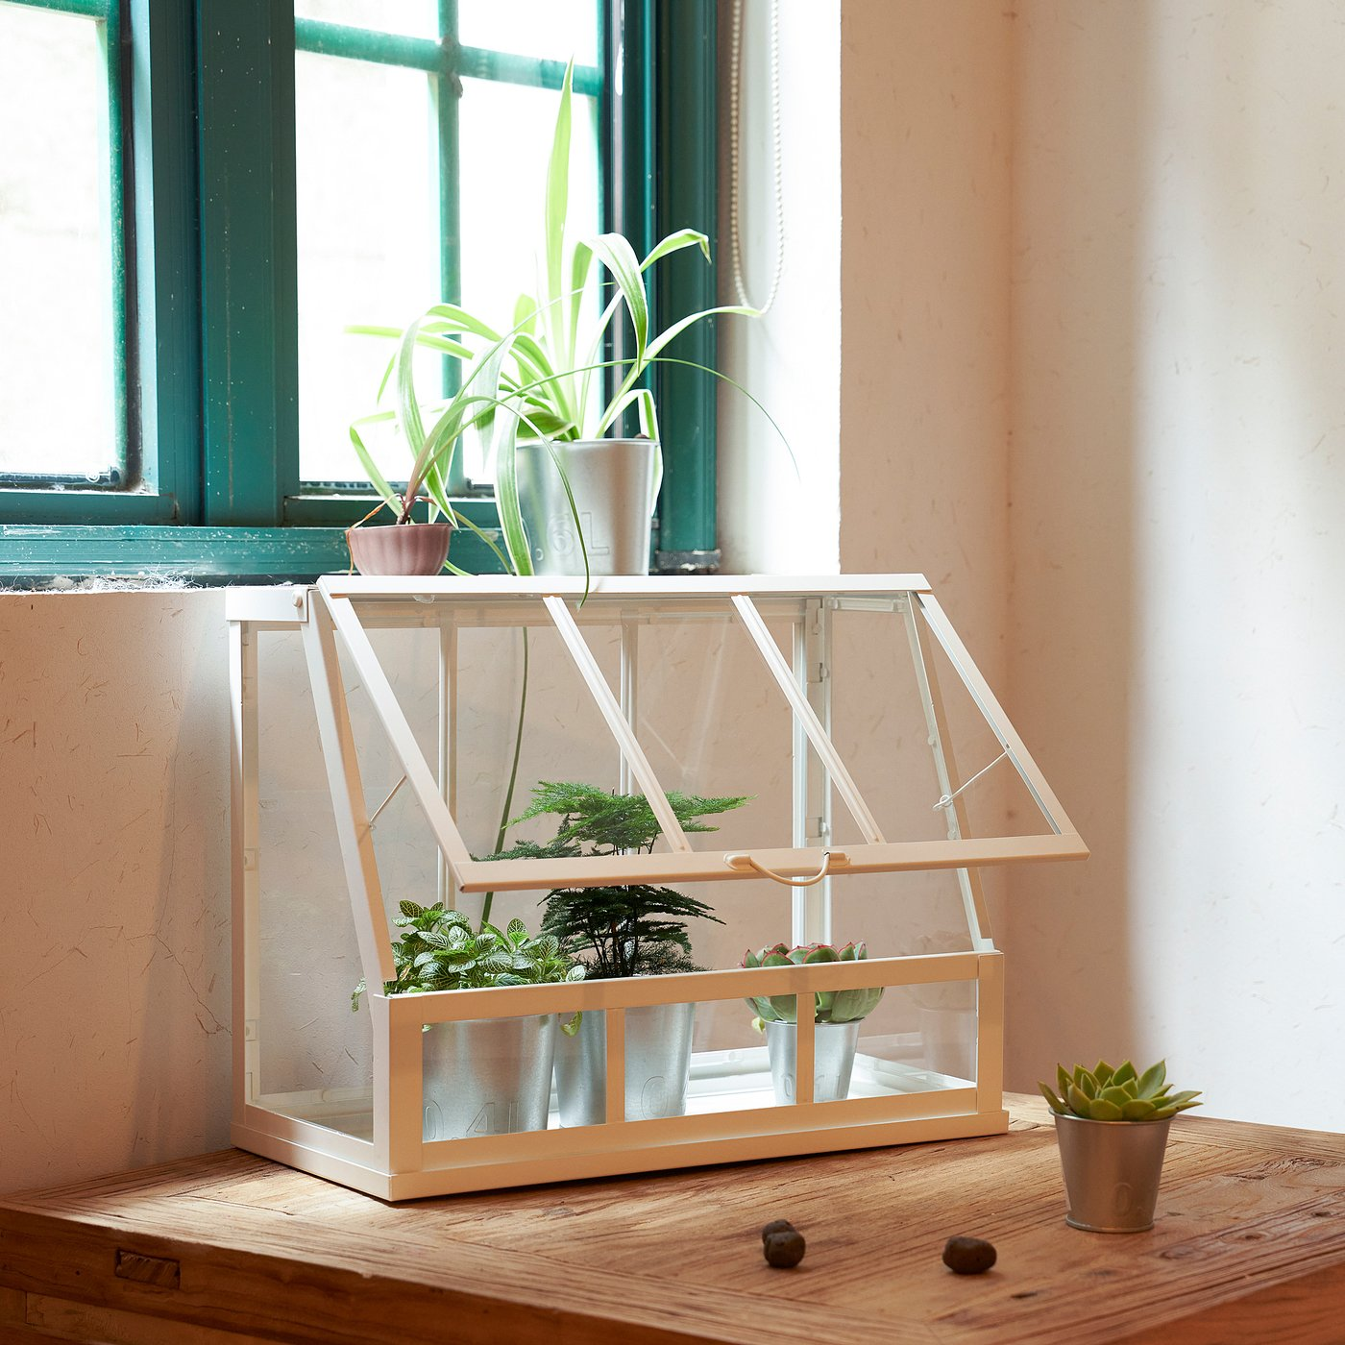
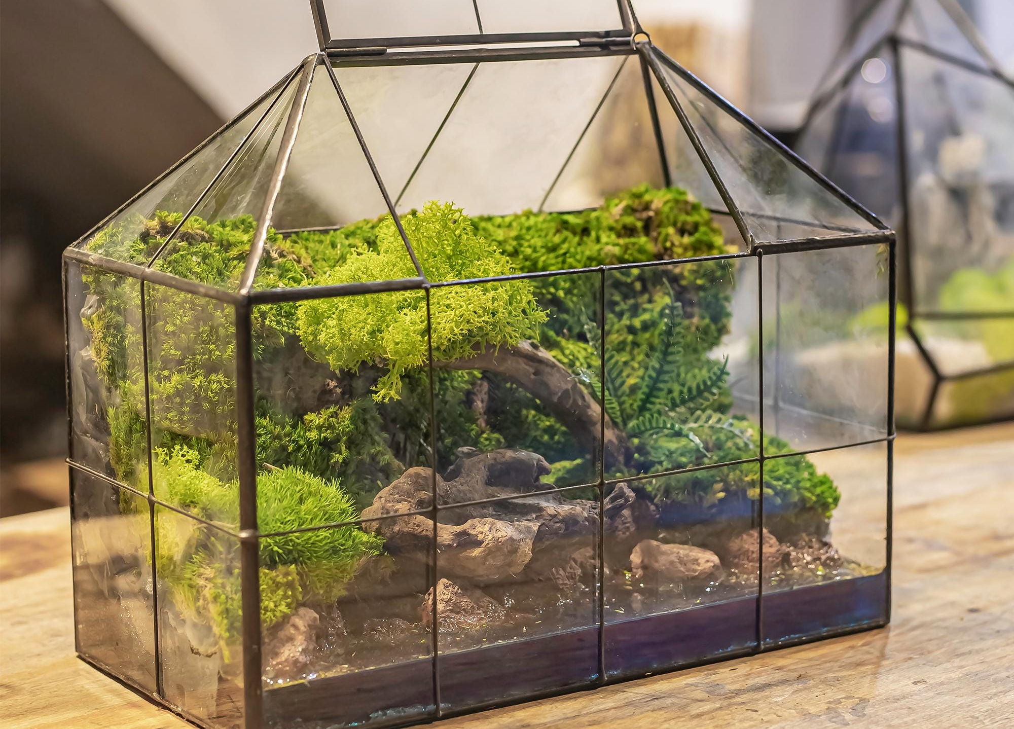
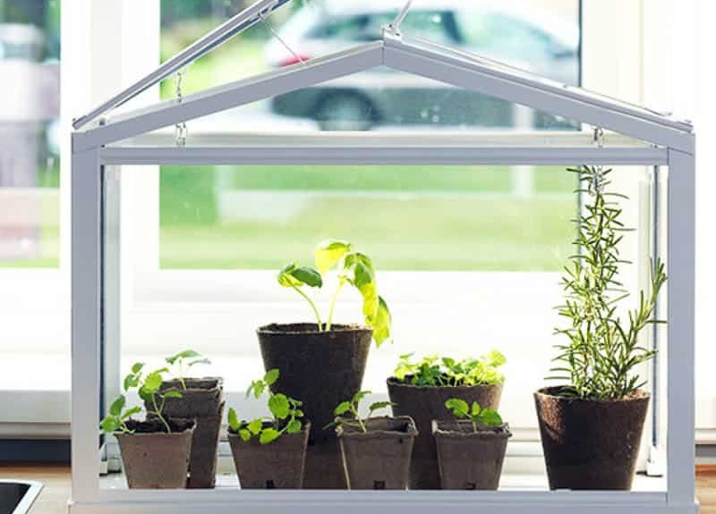

Slide 5
Goal Statement
Design and build a compact mechanism that opens and closes a tabletop greenhouse whose sides are constrained by adjacent walls/edges—no linkages may sweep outside the footprint. The mechanism shall articulate the top and front panels to provide full, unobstructed plant access and offer stable, adjustable hold-positions along the motion path for customizable ventilation.

Slide 6
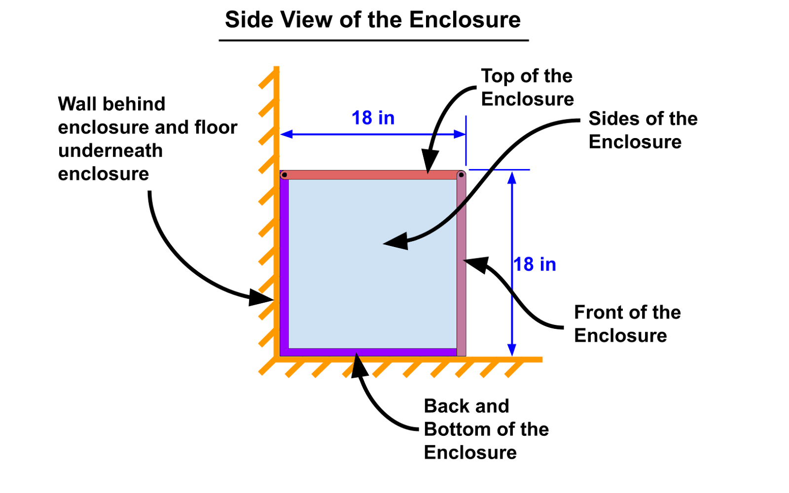
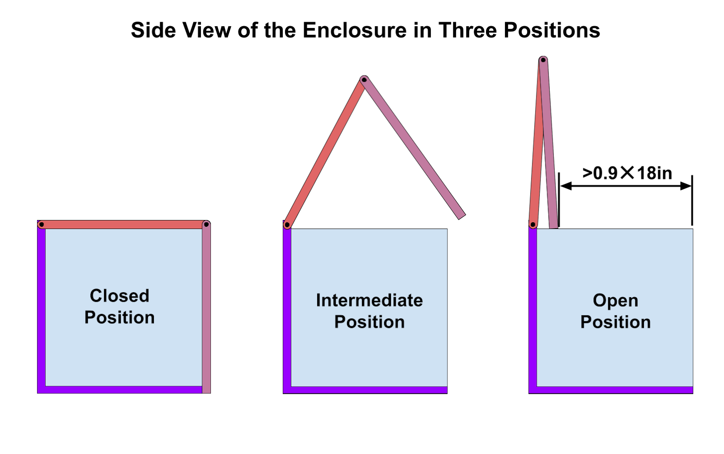

Slide 7
Project Specifications
Provide smooth, controlled motion for fragile glass panels (1/8” thick)
Enable access to plants from both top and front faces simultaneously
Operate within compact tabletop dimensions (approximately 18” tall × 18”deep × 24” wide)
Incorporate spring balancing to reduce actuation forces and prevent impact damage
The opening above the enclosure must be >90% of the the depth of the enclosure
Mechanism must not extend beyond the greenhouse silhouette when closed
Compatible with placement against a wall
Minimize interference with internal plant growth space
Allow front and top of the enclosure to be positioned at any position between open and close and remain in place
Fold the top and front panels above the enclosure, creating unobstructed access for plant maintenance
Optimize linkage geometry to provide smooth velocity profiles while maintaining mechanical advantage throughout the operating range
Support the weight of the front and top of the enclosure ( ~ 5lb each)

Slide 8
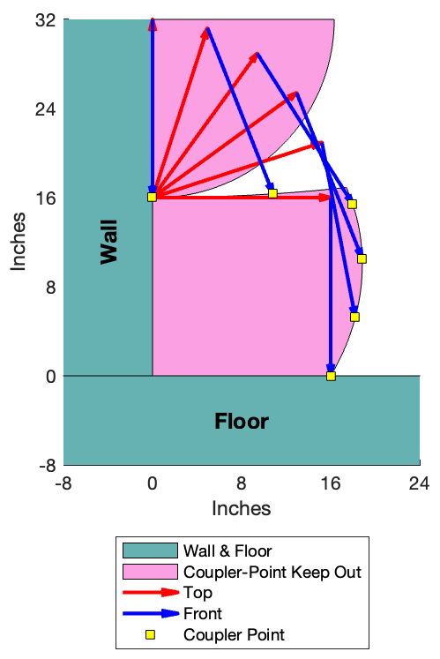
Notes:
we decided on motion generation for a coupler point. this coupler point can be attached to any point along the front surface.

Slide 9
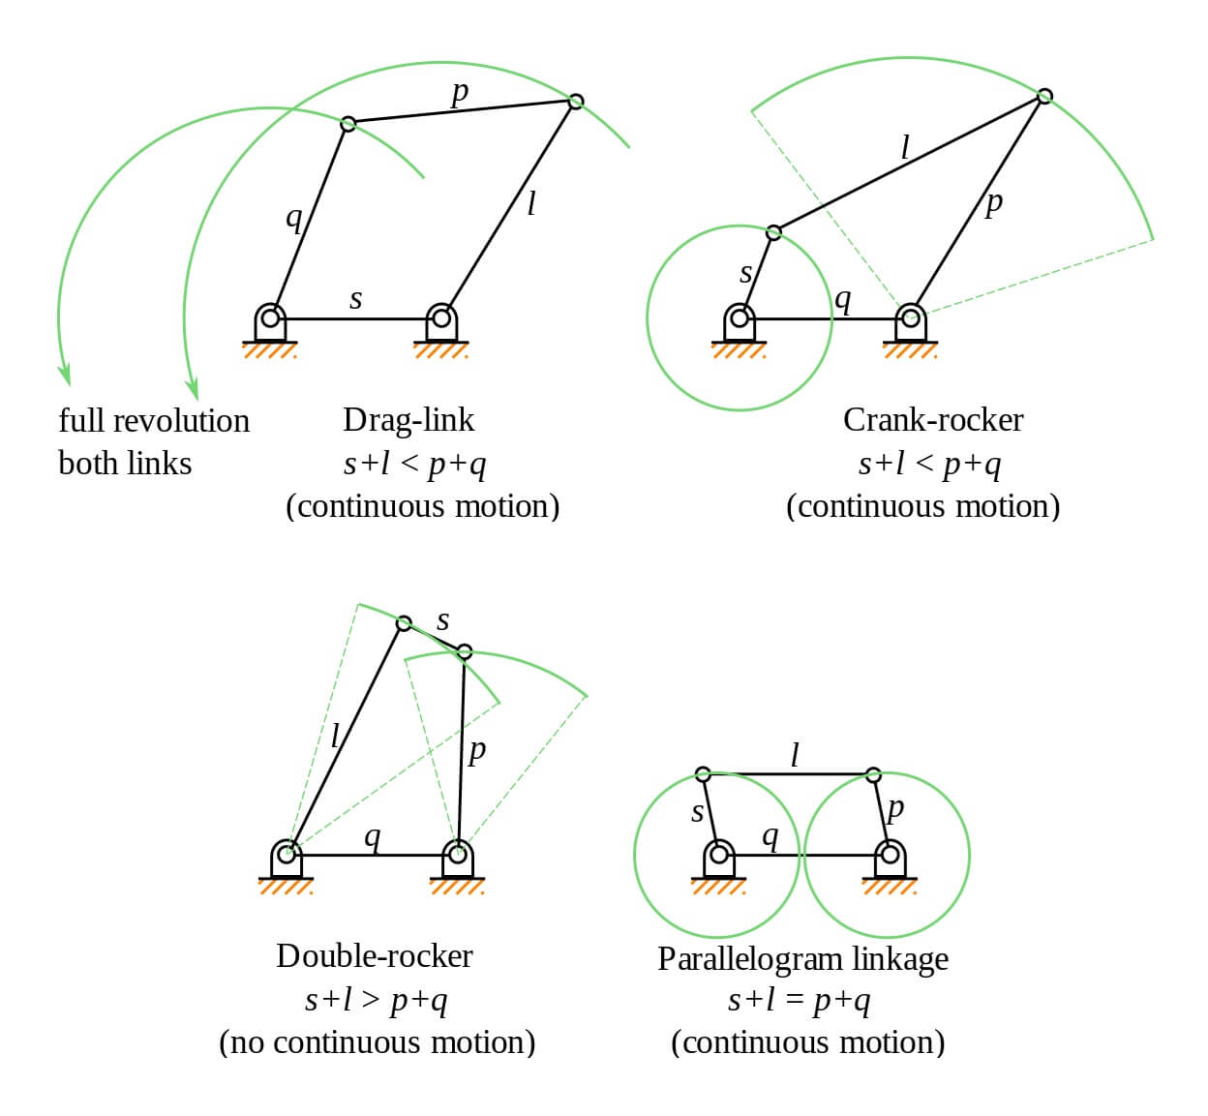
Type Synthesis - 4 Bar

Slide 10
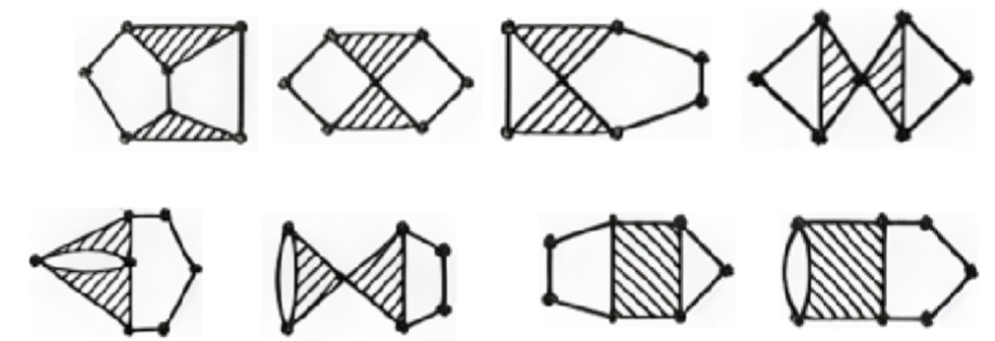
Type Synthesis - 6 Bar
Notes:
Systematic enumeration of basic kinematic chains (BKCs) from this KLSS, with application of the degree-of-freedom distribution criterion to eliminate configurations containing zero-freedom subchains, yields two valid BKCs: the Watt chain, characterized by two ternary links sharing a common connection, and the Stephenson chain, where the ternary links are separated by binary links.

Slide 11
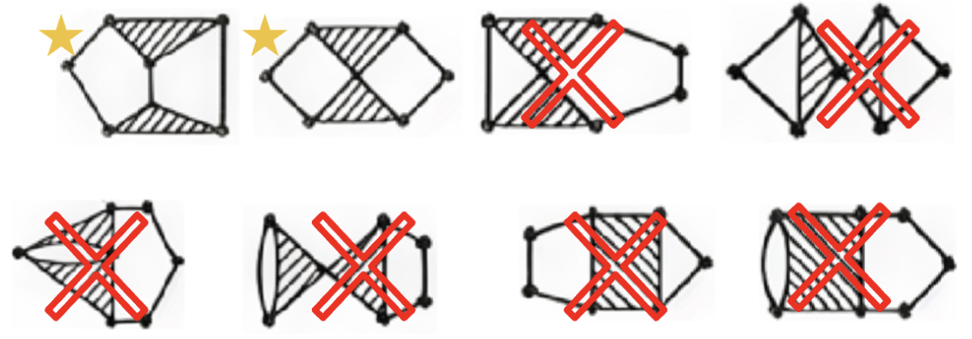
Type Synthesis - 6 Bar

Slide 12
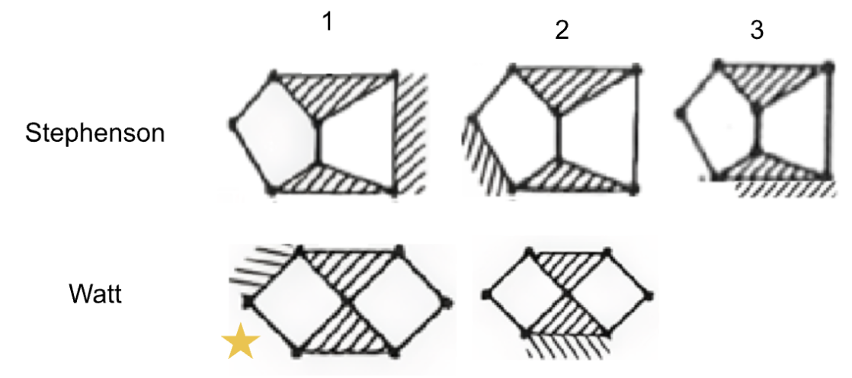
Notes:
Grounding different links within each BKC through kinematic inversion produces five unique topological variations: Watt I, Watt II, Stephenson I, Stephenson II, and Stephenson III. Each inversion was systematically evaluated against design-specific criteria following the approach demonstrated in the Type Synthesis Handout. The critical differentiator proved to be ground pivot accessibility: Watt II, Stephenson II, and Stephenson III all require ternary ground links with three ground pivots, which cannot be practically accommodated on the compact greenhouse base structure without interfering with the interior growing space or requiring pivots at incompatible heights. Stephenson I, while featuring only two ground pivots, exhibits an extended structure with separated ternary links that results in longer link lengths and potentially unfavorable transmission angles for this application.

Slide 13
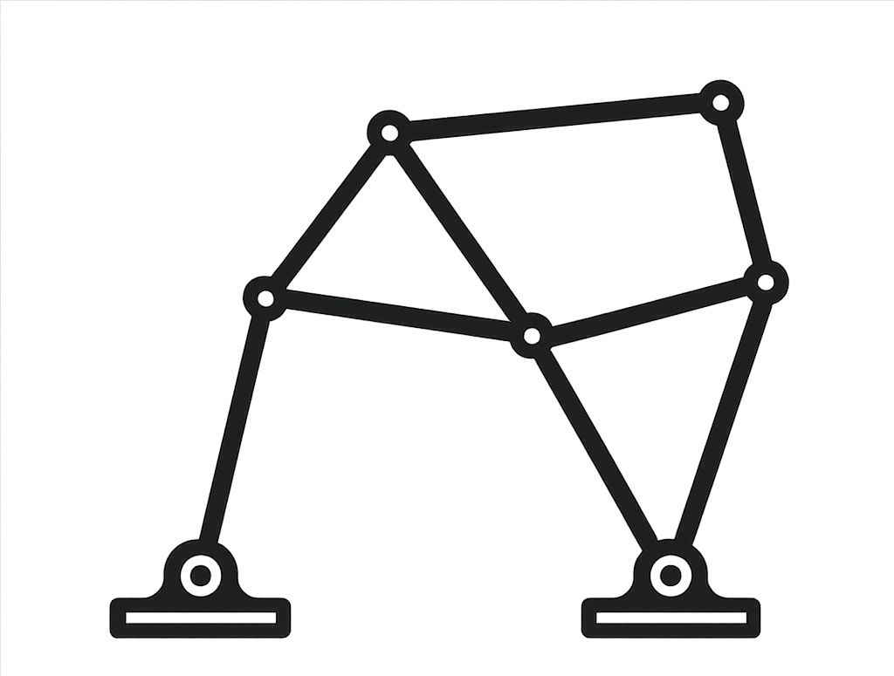

Where We Are Now
Chosen chain to explore: Watt I
Next steps: Develop MatLab program to explore solutions using ground pivot specification.

